Slide 1
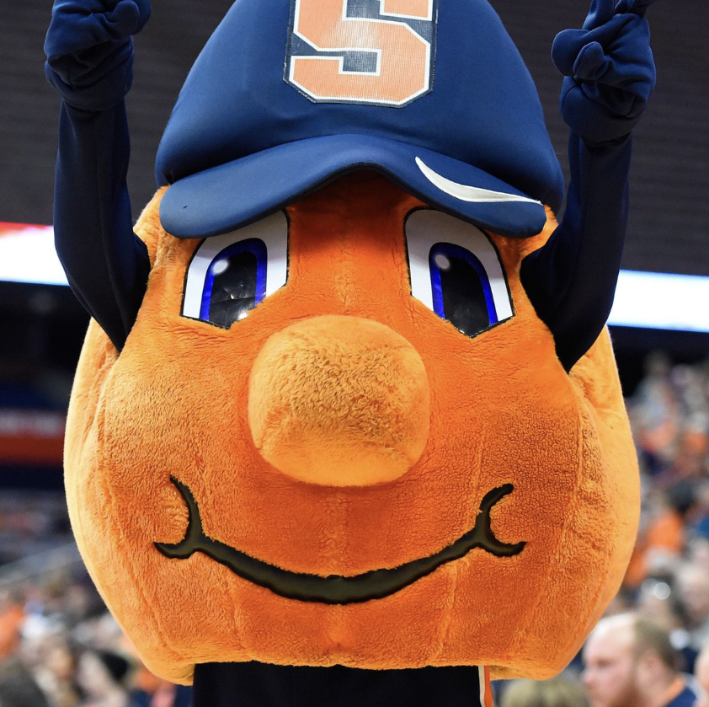
SUStays a comprehensive platform for student housing
Group 5
-SIDDHARTH ASATI
-SAMPADA REGMI
-VRUSHALI LAD
-INDRANEEL MILIND TIRMARE

Slide 2
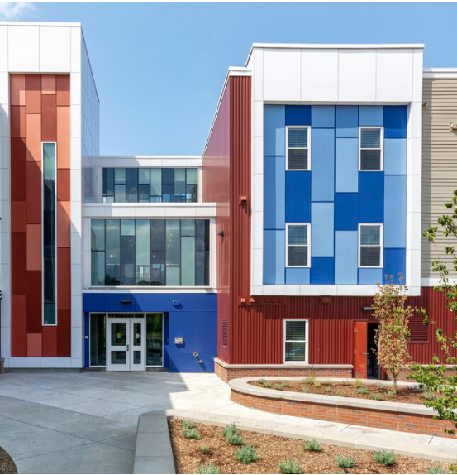
INTRODUCTION
Revolutionary Platform: SUStays is a game-changer for student housing, offering an intuitive design for easy navigation and user satisfaction.
Customized Searches: With advanced filters, students can tailor their housing search based on location, budget, preferences, and accessibility features.
Perfect Roommate Matches: SUStays uses a sophisticated algorithm to ensure compatible living arrangements, considering factors like lifestyle and study habits.
Trusted Listings: Verified properties and a transparent review system build trust, providing students with reliable information for confident decision-making.
Campus Integration: SUStays seamlessly integrates with educational institutions, offering real-time insights into housing proximity to academic facilities for informed choices.

Slide 3
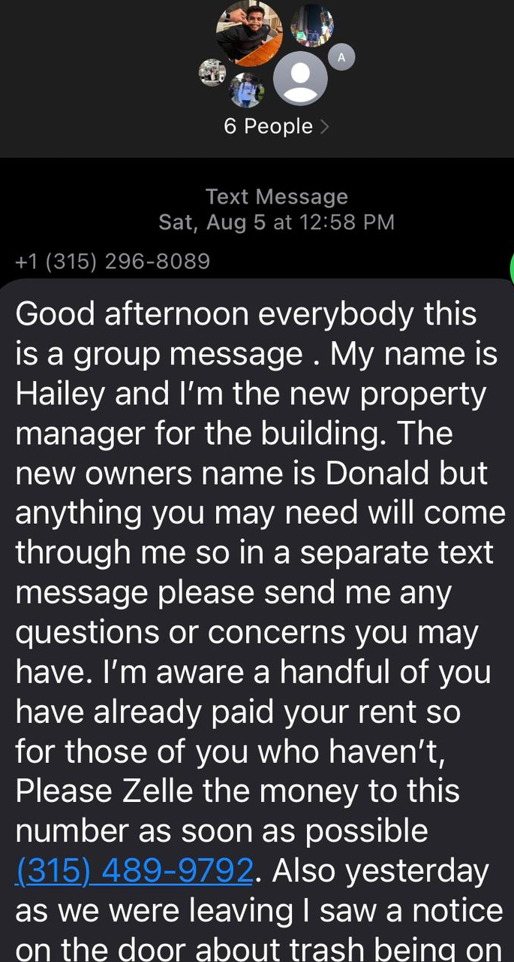
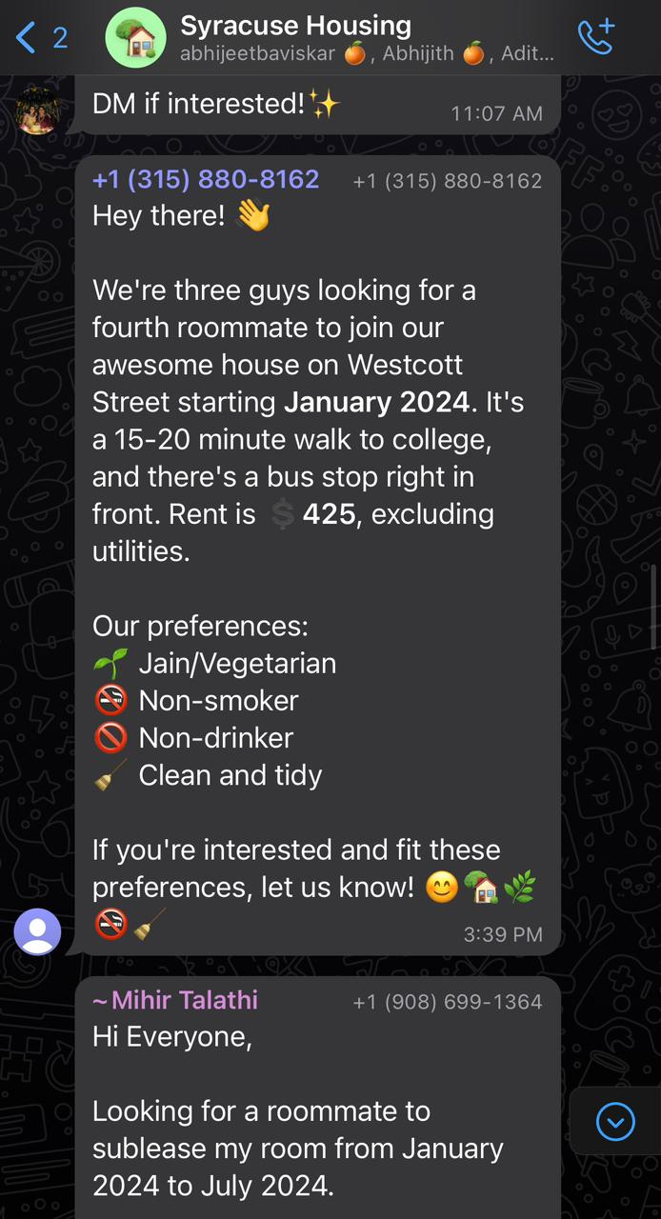
Flaws in existing systems
Lack of a centralized system results in information scattered across various platforms like WhatsApp and iMessage.
Communication through messaging apps limits transparency in housing details and preferences.

Slide 4
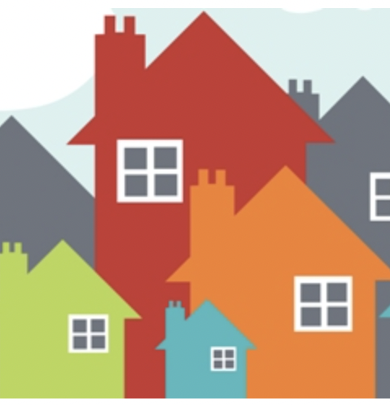
Proposed New System
The core objective of SU Stays is to establish an innovative platform that harnesses AI capabilities to simplify and enhance the student housing search experience.
Comprehensive Features: SU Stays aims to offer sophisticated filtering and roommate-matching capabilities.
Initial Focus on Student Housing: The platform's primary focus is on transforming the student housing landscape, addressing the challenges faced by students.
Potential for Future Expansion : While concentrating on student housing initially, SU Stays is designed with scalability in mind, allowing for potential expansion into other housing markets to meet diverse accommodation needs.
Interactive Communication : SU Stays introduces an interactive platform where students can seamlessly exchange information and preferences.

Slide 5

Benefits
Efficient Housing Searches
Roommate Compatibility
Integrated Campus Experience
Transparency and Trust
Community Building

Slide 6
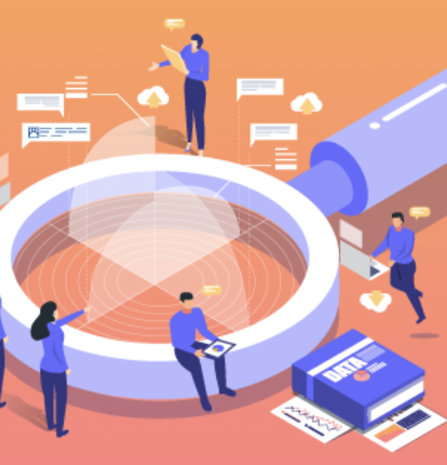
Scope of Project
Platform Development: Design and develop a user-friendly web and mobile application for students to search and find housing listings based on their specific preferences and requirements.
Advanced Filtering: Implement advanced filtering options allowing students to refine their housing search by factors such as room type (1BHK/2BHK), dietary preferences (vegetarian/non-vegetarian), proximity to educational institutions, rental price range, and more.
Roommate Matching: Develop a sophisticated roommate-matching algorithm that enables students to connect with compatible roommates based on shared interests, habits, and lifestyle choices.
Messaging and Communication: Provide integrated messaging and communication tools within the platform for users to contact potential roommates and landlords, schedule property visits, and discuss rental terms.

Slide 7
Key Requirements
Advanced AI Capabilities: Implement sophisticated AI algorithms for personalized filtering and roommate-matching.
Intuitive User Interface (UI): Develop a user-friendly interface for seamless navigation and information exchange.
Scalable Infrastructure: Build a scalable platform to accommodate potential growth and market expansion.
Transparent Communication Hub: Create a platform for students to openly communicate preferences and information.
Security and Privacy Measures: Implement robust security protocols to protect user data and maintain privacy.

Slide 8
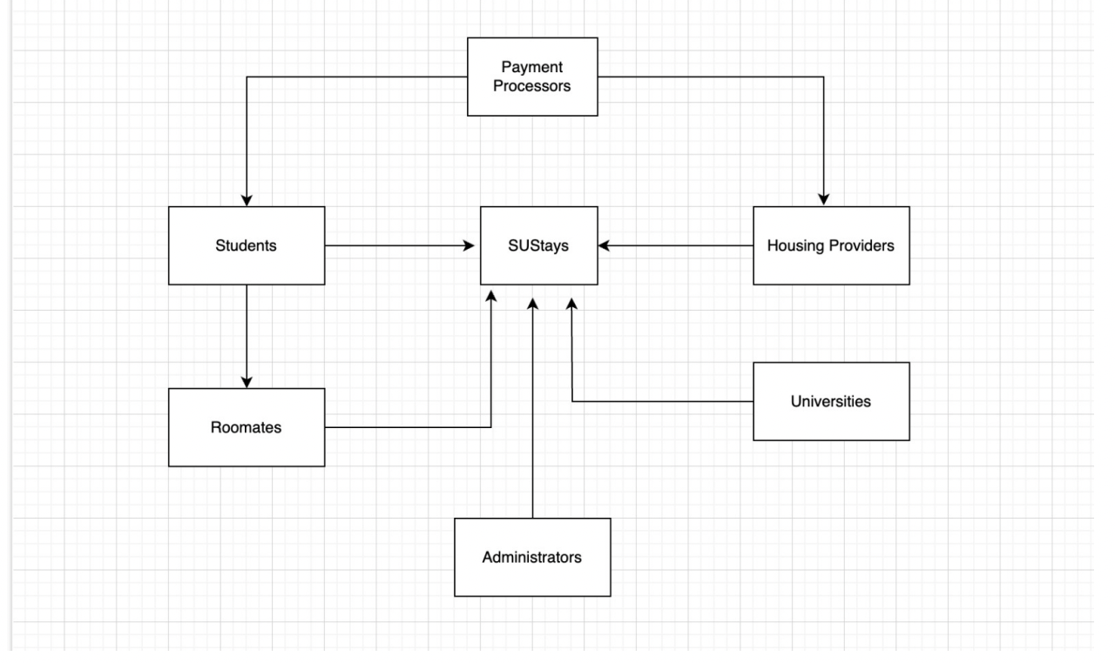
Context Diagram

Slide 9
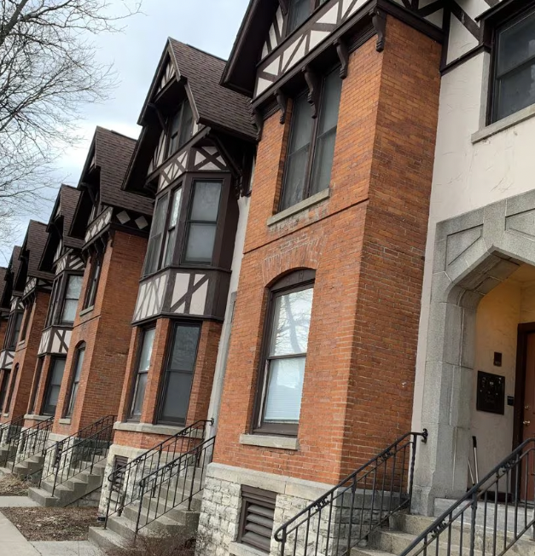
Students: Students will use SUStays to search for housing and roommate options, manage their profiles, and communicate with potential roommates and housing providers.
Roommates: Individuals looking to share accommodations can create profiles, search for compatible roommates, and communicate within the platform.
Housing Providers: Housing providers list available accommodations, manage listings, respond to inquiries, and update availability status.
Universities: Universities can provide information about nearby housing options.
Administrators: Oversee user activity, resolve disputes.
Payment Processors: Handle transactions between students, roommates, and housing providers
Customer Support: Assist users with inquiries, troubleshoot issues.

Slide 10
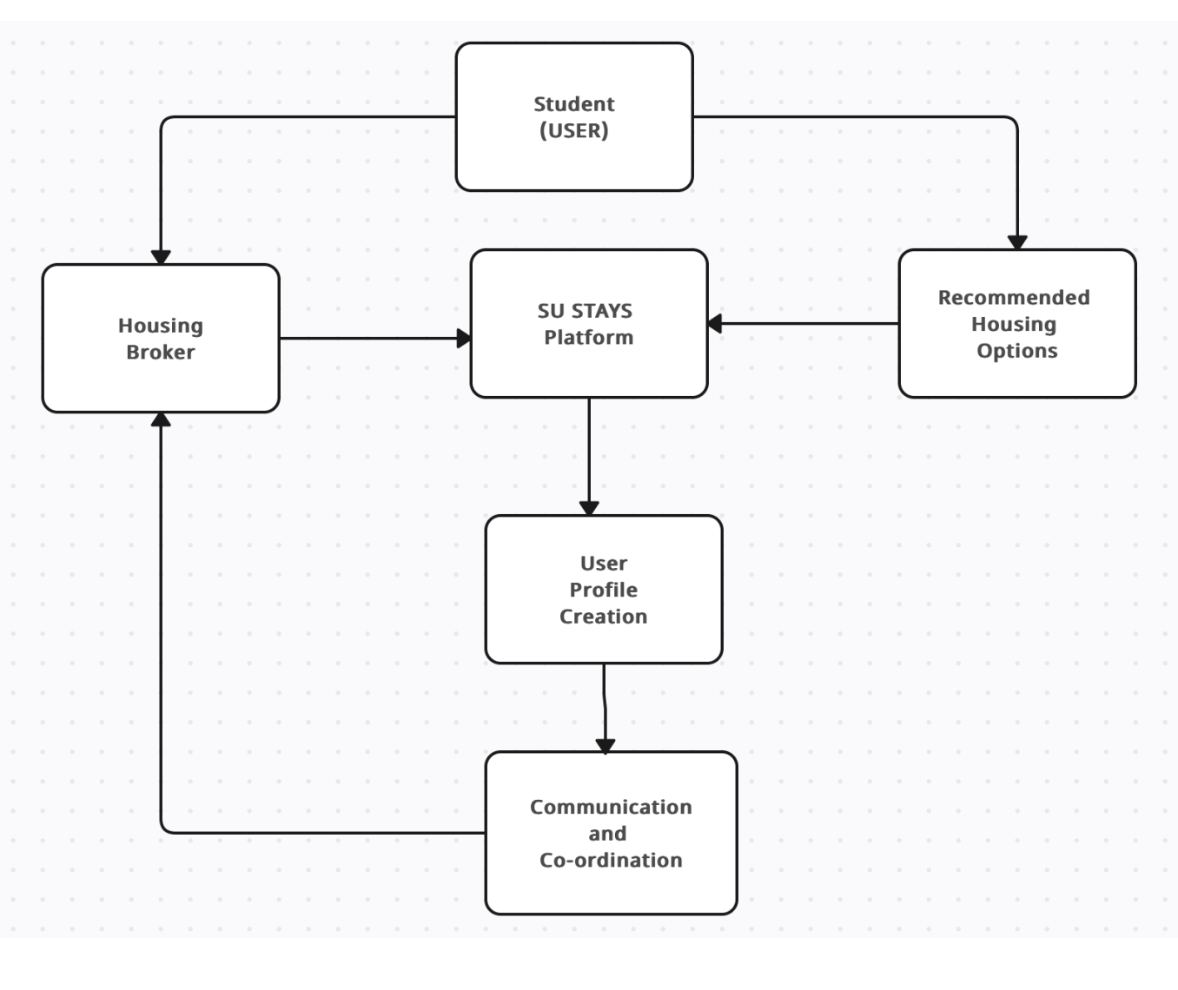
Level-0 DFD

Slide 11
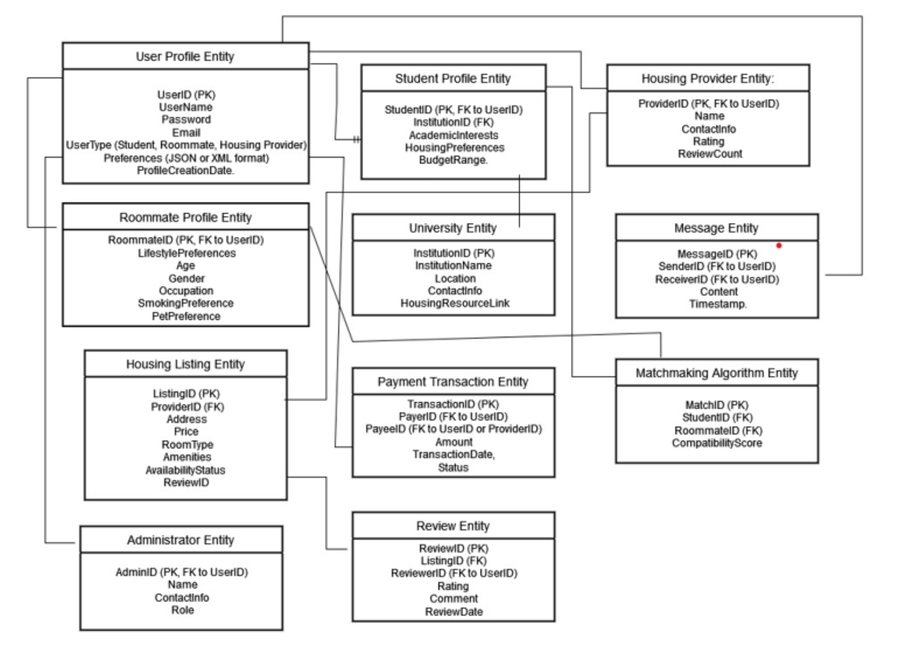
ER -DIAGRAM

Slide 12
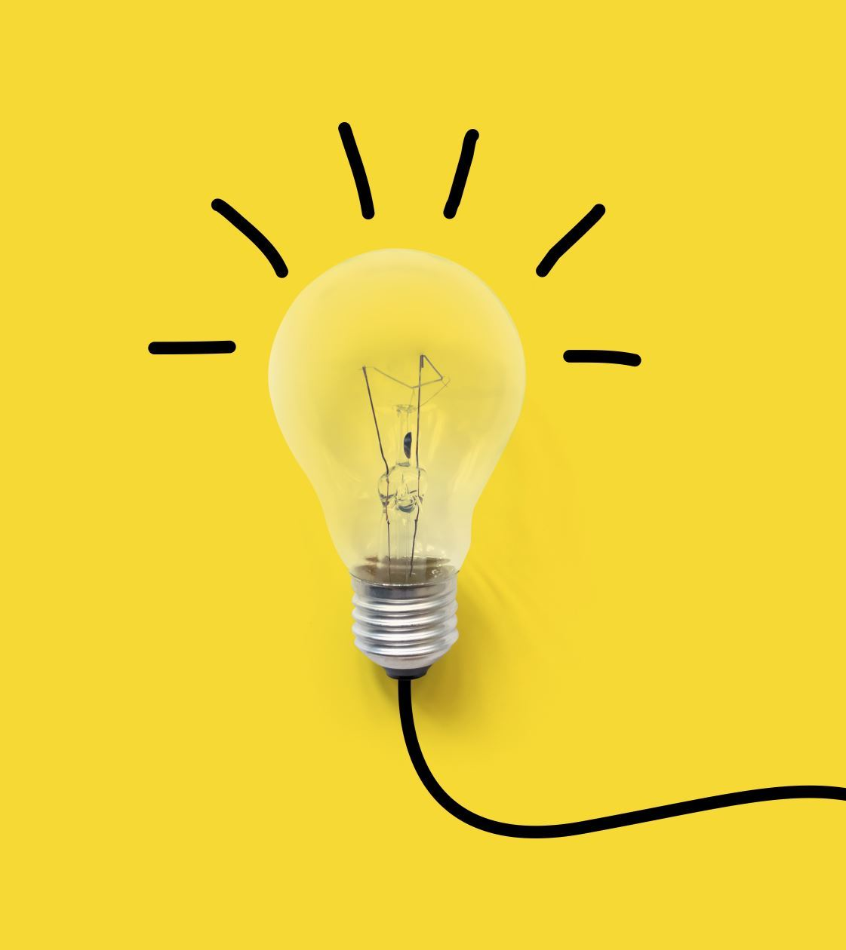
Feedback from users
Intuitive Design: The intuitive design and user-friendly interface made my housing search process incredibly straightforward
Effective Filtering System: The filtering system and roommate-matching algorithm were a game-changer in finding the perfect housing options for me
Interest in Growth: As a property owner, I'm excited about the potential expansion of SUStays and appreciate its adaptability to market needs.
Adaptability Appreciation: "SUStays' adaptability is impressive and makes it stand out from other platforms.
Proactive Technical Support:The platform's feature for addressing technical issues promptly is a major plus. It shows they value user experience.

Slide 13
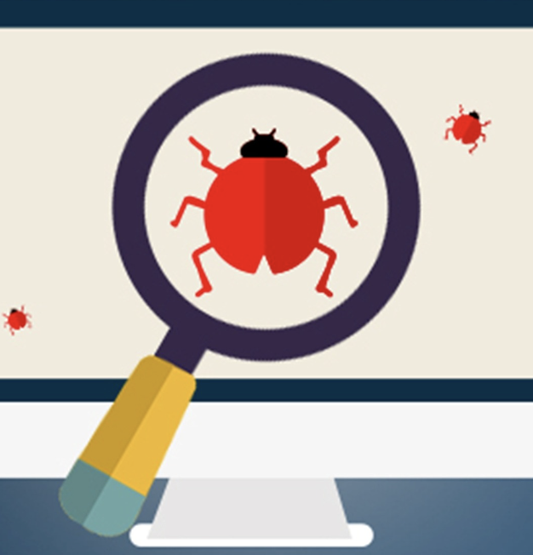
Testing
Comprehensive Examination:
The testing phase involved a thorough examination of SUStays' algorithms, functionality, security features, and user interface.
Scenario Simulation:
Multiple rounds of testing simulated diverse scenarios to ensure SUStays could handle a wide range of student housing situations and user interactions reliably.
Manual and Automated Testing:
Both manual and automated testing were employed to identify and address bugs, errors, and other issues that could impact the system's performance.
Load Testing for Scalability:
Extensive load testing assessed SUStays' capability to manage large volumes of housing applications and data.
Ensured the platform's scalability to meet the demands of a growing user base.
User Feedback Integration:
Collaboration with beta users during the testing phase allowed for gathering valuable feedback.
Feedback was instrumental in making improvements to the system before the official launch.

Slide 14
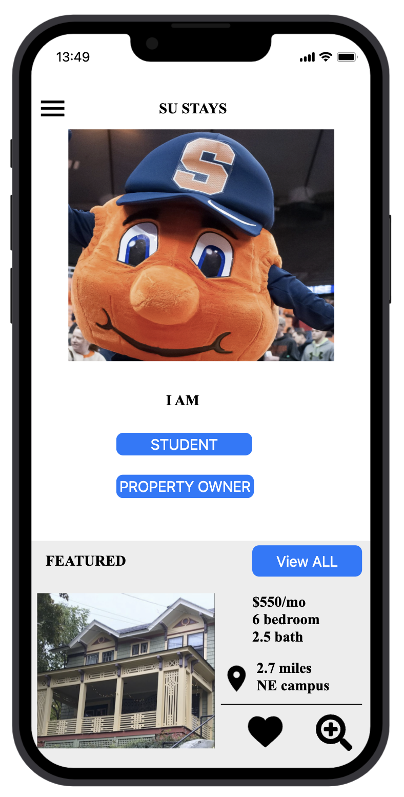
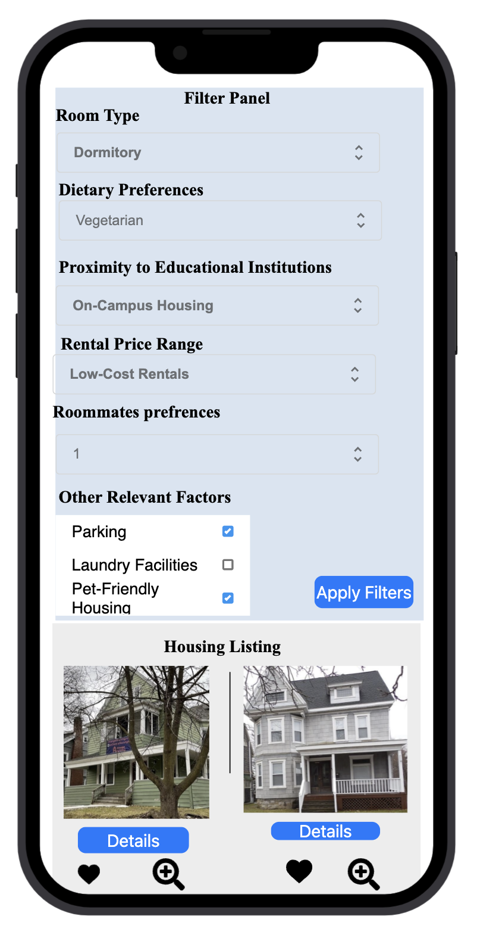
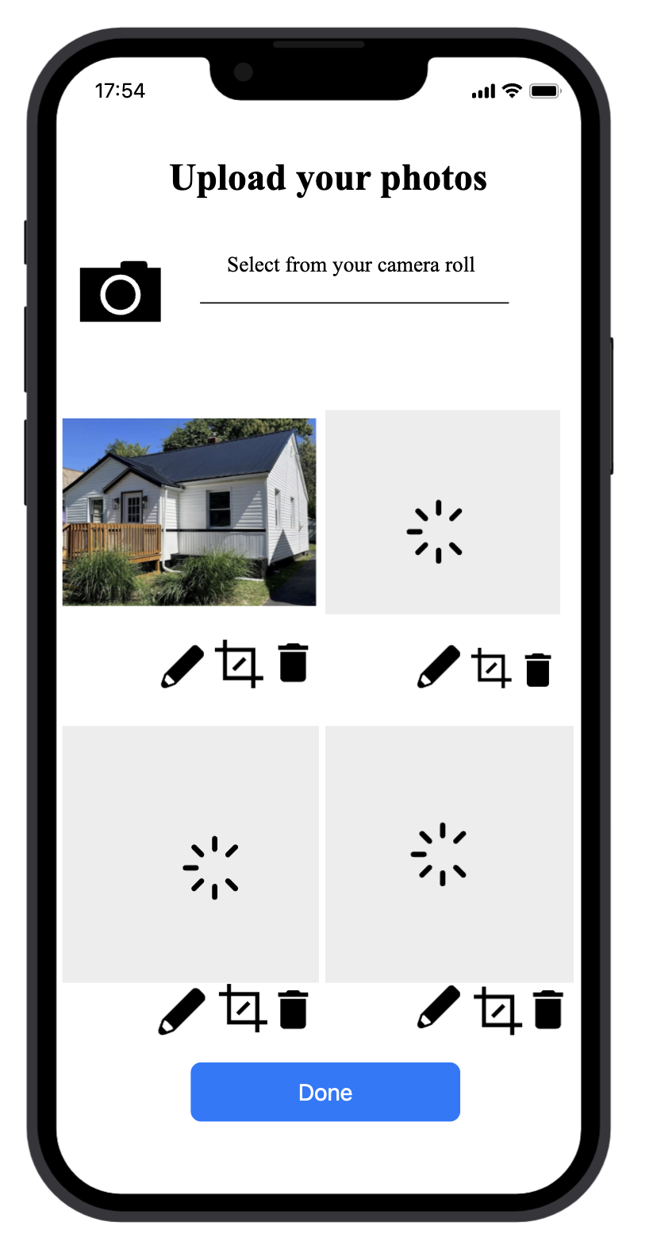
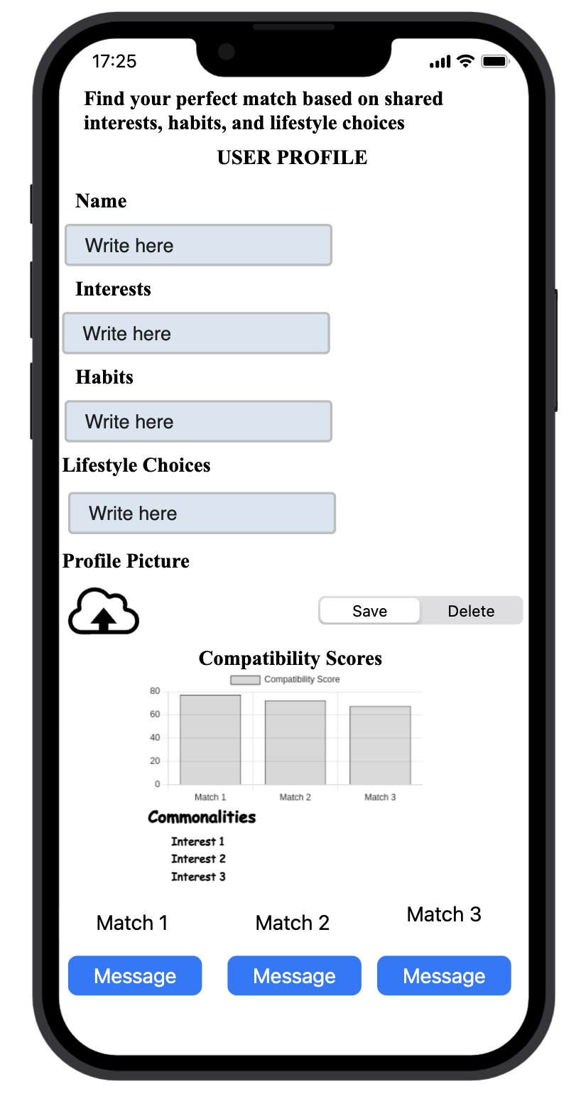
Implementation

Slide 15
Different Approach to the project?
Traditional Approach: In this approach, the project team would follow a well-defined, step-by-step process to develop the AI-powered SU Stays database. The team would first gather requirements, then design the system, followed by implementation, testing, and deployment.
Agile Approach: In this approach, the project team would focus on delivering the most important features of the database first and then gradually add more features based on user feedback. The team would work in short sprints, with frequent releases of working software.
Waterfall Approach: In this approach, the project team would follow a linear process, where each phase of the project is completed before moving on to the next phase. The team would gather all requirements, design the system, implement it, test it, and then deploy it.
Prototyping Approach: In this approach, the project team would create a basic version of the AI-powered database, known as a prototype, and then refine it based on user feedback. The team would iterate on the prototype until it meets all requirements.
Hybrid Approach: In this approach, the project team would combine elements of the traditional, agile, and prototyping approaches to suit the needs of the project. For example, the team might use agile methodologies for software development but also incorporate some traditional project management practices.

Slide 16

Lessons learned
Collaboration is key: Effective collaboration between team members, stakeholders, and end-users is essential for the success of the project. Regular communication, feedback, and collaboration ensure that the project stays on track and meets its objectives.
Testing is critical: Comprehensive testing and quality assurance are critical to ensure project works A robust testing process can identify and address issues early on in the development cycle, saving time and money in the long run.
Flexibility is important: The project team must be flexible and adaptable to changes in requirements, scope, and timelines. The ability to pivot and adjust quickly to new information or challenges is essential for project success.
User-centric design is crucial: Designing SU Stays with the end-user in mind is crucial to ensuring its effectiveness and adoption. Engaging users early in the design process and incorporating their feedback throughout the project can lead to a more user-friendly and effective system.
Documentation is essential: Documentation is crucial for the long-term maintenance .Creating comprehensive documentation throughout the development process can help future developers understand the system's functionality and make updates or improvements more efficiently.

Slide 17

QUESTIONS
Thank you !!

